Slide 1
Scale Imbalance

Slide 2
Object/Box-Level Scale Imbalance
Scale imbalance occurs when certain sizes of the objects or input bounding boxes are over-represented in the dataset.
Feature Imbalance
The integration of the features from the backbone network is expected to be balanced in terms of low-level and high-level features so that consistent predictions can follow.

Slide 3
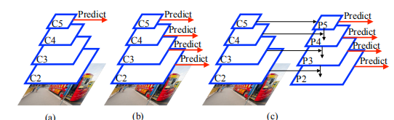
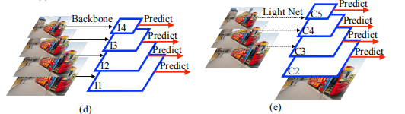
Object/Box-Level Scale Imbalance
Methods predicting from the hierarchy of the backbone features（b）
(SSD MSCNN)
Feature pyramids（c）
(FPN)
Image pyramids（d）
(SNIP SNIPER)
Methods combining image and feature pyramids（e）

Slide 4
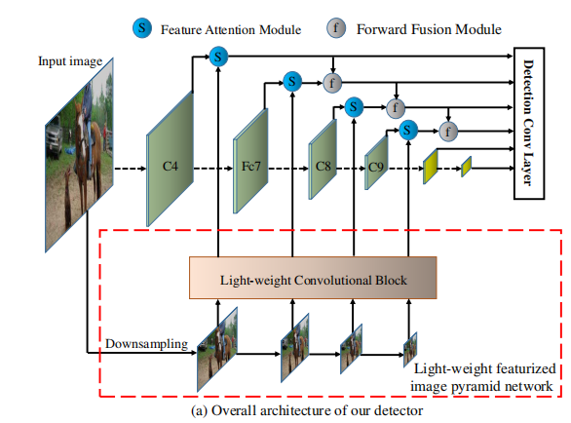
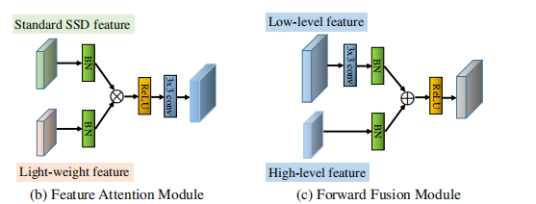
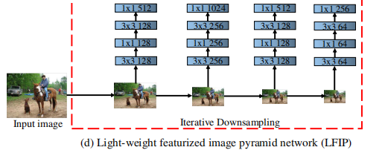
Methods combining image and feature pyramids
Efficient Featurized Image Pyramids
Enriched Feature Guided Refinement Network
MSCF(multi-scale contextual feature module) FGRM(feature guided refinement module)
Super-resolution for small object detection
SR feature generator and discriminator, SR target extractor and small predictor
Scale Aware Trident Networks

Slide 5
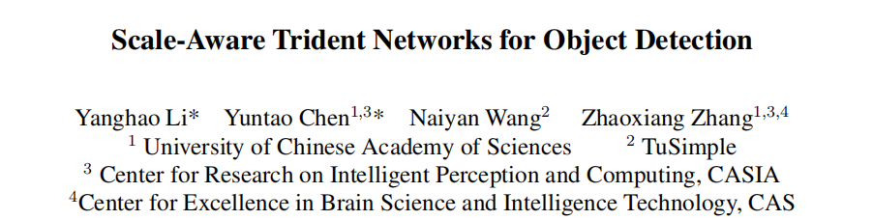

Slide 6
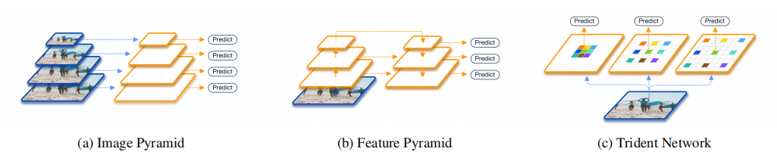
Contributions
We present our investigation results about the effect of the receptive field in scale variation.
We propose a novel Trident Network to deal with scale variation problem for object detection.
We propose a fast approximation, TridentNet Fast.
Our proposed method achieves an mAP of 48.4 using a single model with ResNet-101 backbone.

Slide 7
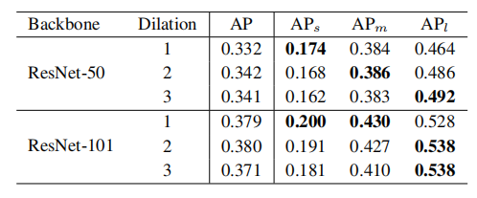
Investigation of Receptive Field
The performance on objects of different scales are influenced by the receptive field of a network.
Although ResNet-101 has a large enough theoretical receptive field to cover large objects (greater than96×96 resolution) in COCO, the performance of large objects could still be improved when enlarging the dilation rate.

Slide 8
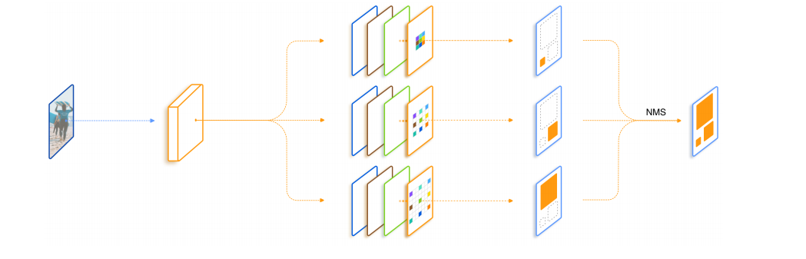
TridentNet

Slide 9
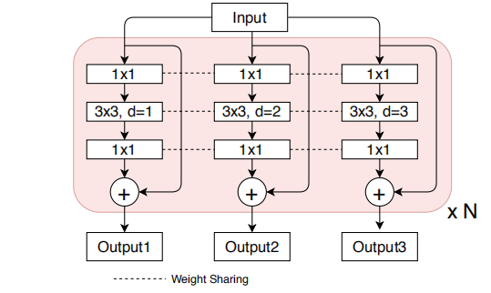
ResNet： a single residual block in the bottleneck style

Slide 10
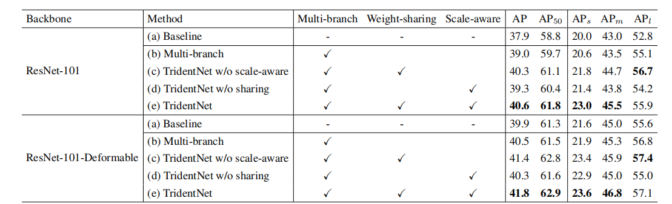
Experiments

Slide 11
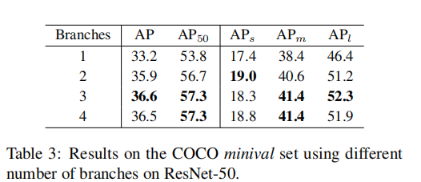
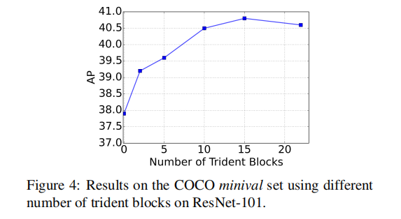
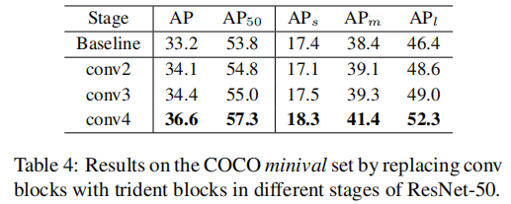
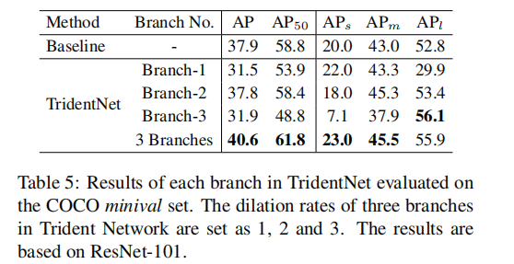

Slide 12
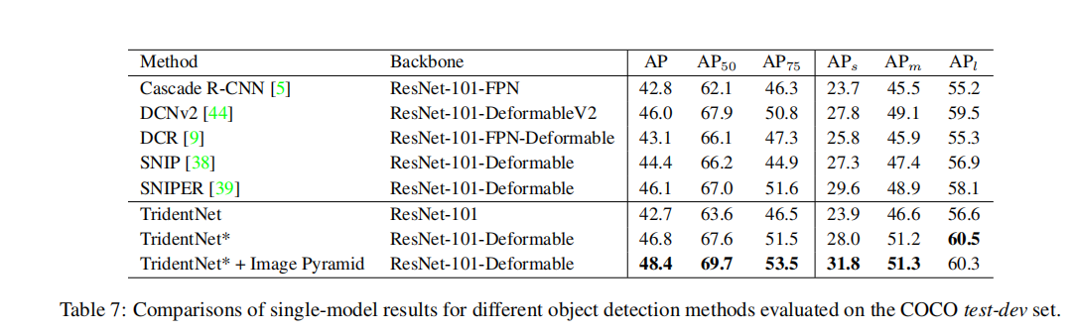

Slide 13
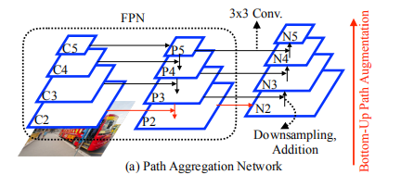
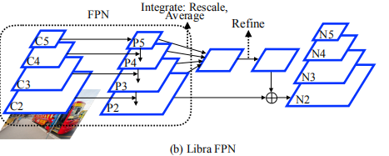
Feature Imbalance
Methods Using Pyramidal Features as a Basis
Methods Using Backbone Features as a Basis
Scale-Transferrable Detection Network
Parallel FPN
Deep Feature Pyramid Reconfiguration
Zoom Out-and-In Network
Multi-Level FPN
NAS-FPN

Slide 14
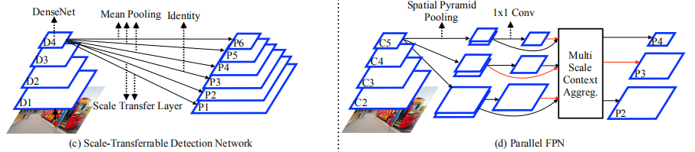
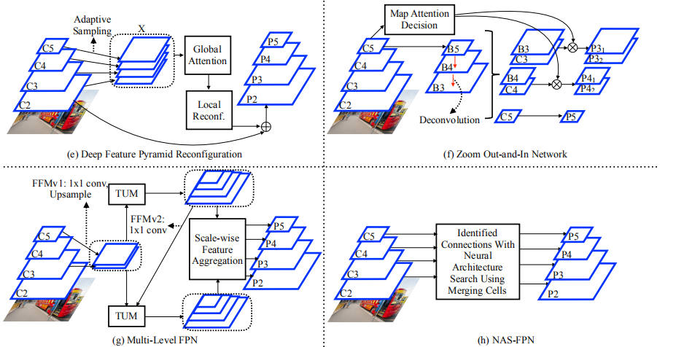

Slide 15
Open Issues
Characteristics of Different Layers of Feature Hierarchies
Image Pyramids in Deep Object Detectors

